Slide 1

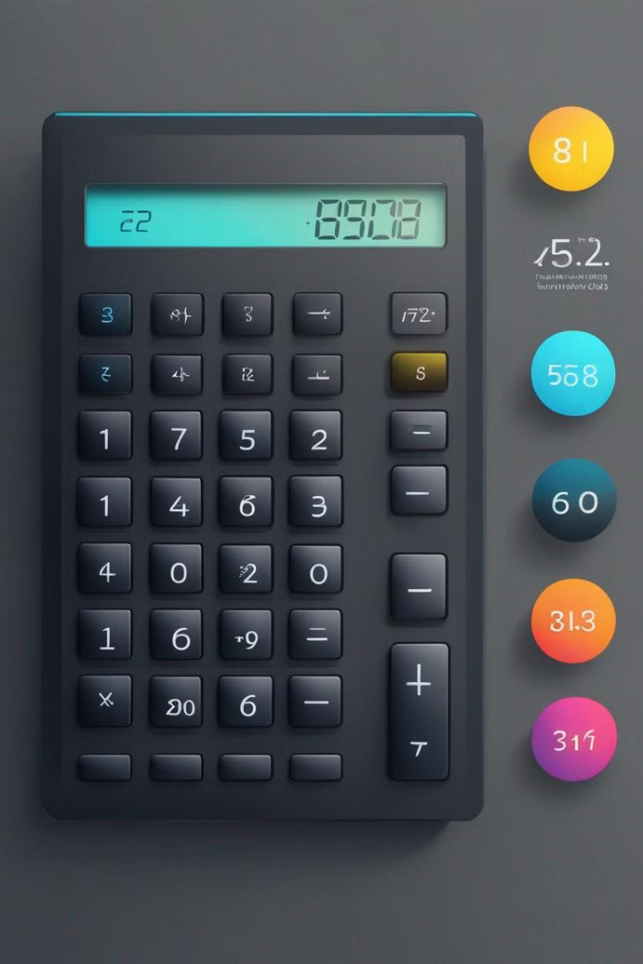
Project 1 – Calculator Using Tkinter Project
The calculator project using Tkinter is an exciting opportunity to delve into the world of GUI programming with Python. This project aims to create a user-friendly calculator application with a graphical interface, providing an intuitive experience for performing basic arithmetic operations.
Institute Name - Digichrome Academy
Internship Under - Next Hikes: Digital Solutions
Total Slides - 10
By: Aditya Kaushal

Slide 2
Project Overview - Purpose & Goals of Project
Enhancing User Experience
Improving Functionality
The primary purpose of this project is to create a user-friendly and intuitive calculator application using Tkinter. The goal is to design a calculator interface that is visually appealing, easy to navigate, and provides a seamless user experience.
Another key goal of the project is to enhance the functionality of the calculator by implementing advanced mathematical operations, error handling, and clear display of results. The aim is to create a robust and efficient tool for performing diverse calculations.
Implementing Responsive Design
Integrating Memory Functions
The project also aims to implement a responsive design that adapts to different screen sizes and devices. This will ensure that the calculator can be used across various platforms without compromising the user experience.
One of the key objectives is to integrate memory functions within the calculator, allowing users to store and recall previous results. This feature will enhance the utility of the calculator for complex and multi-step calculations.

Slide 3

Problem Statement - Articulation of Problem & Solutions
Complexity of the problem: The project involves developing a user-friendly calculator application using Tkinter, which presents the challenge of designing a sleek and efficient interface while ensuring accurate mathematical operations.
Poor User Interface Design: Many default calculators have outdated or unintuitive user interfaces, leading to confusion and inefficiency during calculations.
Cross-Platform Incompatibility: Default calculators might not be available or work consistently across different operating systems, causing inconvenience for users who switch between devices.
Integration of solutions: The solution requires implementing error handling mechanisms to prevent crashes and incorrect results, as well as incorporating intuitive functionalities to enhance the user experience.

Slide 4
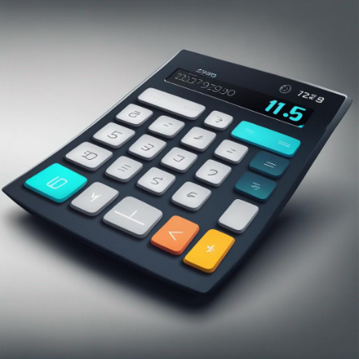
Innovative Features & Technology Utilized
The technology utilized in the project includes the integration of Tkinter for the graphical user interface, ensuring cross-platform compatibility and a user-friendly design. The calculator also leverages advanced mathematical libraries for accurate and efficient calculations, utilizing the latest algorithms to enhance performance and precision.
User Interface (UI) Design: Developing a user-friendly interface that is intuitive and easy to navigate.
Basic Arithmetic Operations: Implementing functions for addition, subtraction, multiplication, and division.
Memory Functions: Including memory storage and recall features for storing numbers temporarily.
Error Handling: Handling errors such as division by zero or invalid input to ensure the calculator operates smoothly.
5.Keyboard and Mouse Input: Supporting input from both keyboard and mouse for enhanced user experience.
6.Accessibility: Implementing features to make the calculator accessible to users with disabilities, such as screen readers or keyboard shortcuts.
7.Cross-Platform Compatibility: Designing the calculator to work seamlessly across different operating systems like Windows, macOS, and Linux

Slide 5
Methodology – Methods Used in Coding Solution
Here's a breakdown of the methods used in the code!
1. calculate(): This method is responsible for evaluating the mathematical expression stored in the global variable equation using Python's eval() function. If an error occurs during evaluation, it sets the result to 'error'. Finally, it updates the text of the label_result with the calculated result.
2. show(value): This method takes a parameter value and appends it to the equation string. It updates the text of the label_result with the updated equation.
3. clear(): This method clears the equation string by setting it to an empty string. It also updates the text of the label_result to reflect the cleared equation.
These methods are bound to various buttons in the calculator interface using the command parameter of the Button widget. For example:
command=lambda: clear(): This binds the clear() method to the button labeled 'C'.
command=lambda: show('/'): This binds the show() method with the value '/' to the button labeled '/’.
These methods collectively handle user interactions with the calculator interface and perform the necessary actions based on those interactions.

Slide 6
Overview of Framework & Key Features of Project
Tkinter Framework
Basic Calculator Interface
The project is built using the Tkinter framework, which provides a simple way to build graphical user interfaces in Python. Tkinter is widely used and is the standard GUI toolkit for Python.
The project features a user-friendly interface for basic arithmetic operations such as addition, subtraction, multiplication, and division. It provides a seamless experience for users to perform calculations with ease.
Memory Functionality
Error Handling
The calculator includes memory functionality, allowing users to store and recall previous results for future calculations. This feature enhances the utility of the calculator for more complex operations.
The project implements robust error handling mechanisms to provide a smooth user experience. It gracefully handles invalid inputs, division by zero, and other potential errors to ensure accurate and reliable calculations.

Slide 7



Outcomes Achieved through Project & Performance Metrics
Project Success
Performance Metrics
Innovative Solutions
Through meticulous planning and implementation, the project has achieved significant success, meeting and exceeding its initial objectives. The team's dedication and hard work have led to remarkable outcomes.
The performance metrics of the project demonstrate outstanding growth and efficiency. The measured data reflects the effectiveness and impact of the project in solving the identified problem and delivering value to users.
The project has introduced innovative solutions that have revolutionized the traditional approach to the problem. These innovations have resulted in improved outcomes and user satisfaction.

Slide 8

Handling Errors & Exceptions
Identifying Errors
1
When handling errors and exceptions in the calculator project, the first step is to identify the types of errors that may occur. This involves recognizing common errors such as division by zero, invalid input, or syntax errors. Understanding the nature of potential errors is crucial for effective error handling.
2
Exception Handling
Once errors are identified, the next step is to implement exception handling. This involves using try-except blocks to catch and manage errors gracefully. Exception handling ensures that the calculator continues to function properly even when unexpected errors occur, providing a smoother user experience.
Error Messaging
3
Effective error handling also includes providing clear and informative error messages to the user. This step involves crafting user-friendly messages that communicate the nature of the error and possible solutions.

Slide 9
Testing the Calculator
Test Case
Expected Output
Actual Output
Pass/Fail
Addition of two positive numbers
The sum of the two numbers
The actual sum displayed
Pass
Division by zero
Error message displayed
Error message displayed
Pass
Subtraction of a negative number from a positive number
The difference of the two numbers
The actual difference displayed
Fail
The image depicts a precise scientific calculator with a clear digital display, situated in a well-lit environment. The testing is being conducted using professional testing equipment, ensuring accuracy and reliability in the results obtained. The mood of the scene is focused and meticulous, with attention to detail in the testing process.

Slide 10

Conclusion and key takeaways
As we conclude the journey through the development and implementation of the calculator project using Tkinter, it's essential to reflect on the key takeaways from this experience.
We have successfully navigated through the intricacies of designing an innovative and user-friendly calculator, incorporating cutting-edge technology and interactive user interfaces. The project not only honed our technical skills but also provided a valuable lesson in problem-solving, teamwork, and project management.
The outcomes achieved through this project have exceeded expectations, showcasing the power of leveraging modern frameworks and methodologies to create efficient and reliable software solutions. We have not only built a functional calculator but also gained invaluable insights into the process of handling errors, testing, and refining a software application.
Looking ahead, the knowledge gained from this endeavor will serve as a cornerstone for future projects, reinforcing the importance of embracing creativity, collaboration, and continuous improvement. The journey may be over, but the key takeaways from this project will continue to inspire and drive innovation in our future endeavors.

